Slide 1
ChiPy (Chicago Python User Group)
Paul Ebreo
June 2024

Slide 2
About Me
- ChiPy member since mid 2000s
- worked in C# for dayjob
- work in Python for personal projects
- worked with Django
- ML 2021 predictions were correct

Slide 3
Talk links / resources
pebreo.github.io/chipy2024

Slide 4
Agenda
- ML recap & proposed solns
- Hierarchical PGMs
- Resources

Slide 5
Old brain
New brain
- requires a lot of training data
- no model of the world
- low generalization
- requires low training data
- has causal model of the world
- high generalization

Slide 6
Recap
- Limit 1 : requires massive data
Solution 1: assumptions
Limit 2: no causal model of real world
Solution 2: memory + senses + imagination

Slide 7
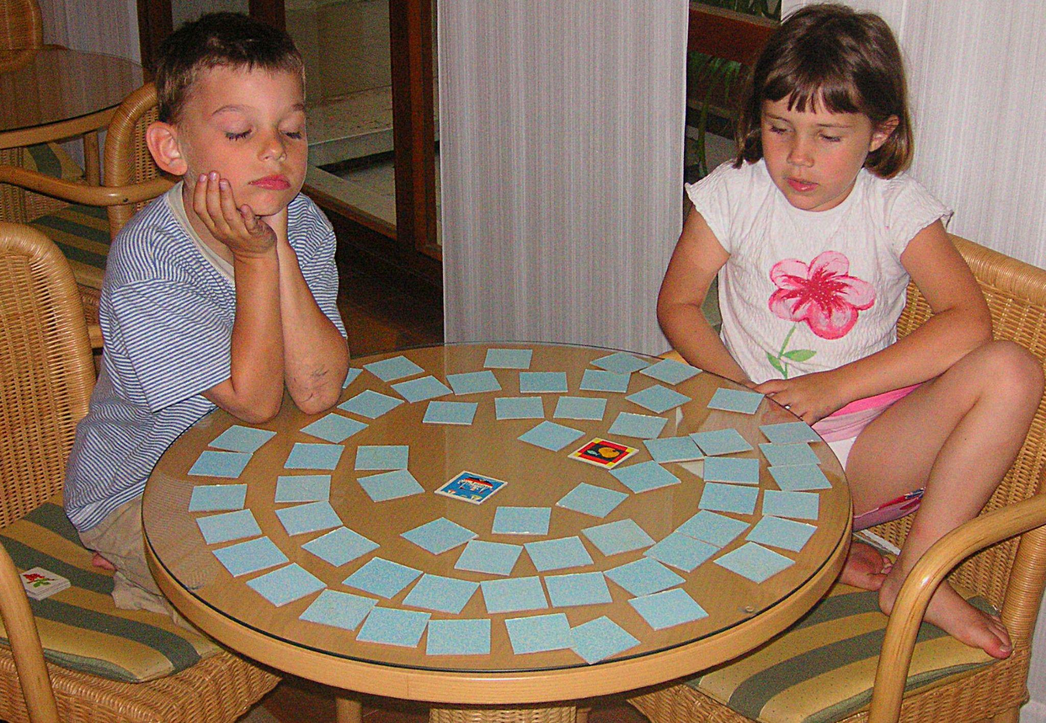
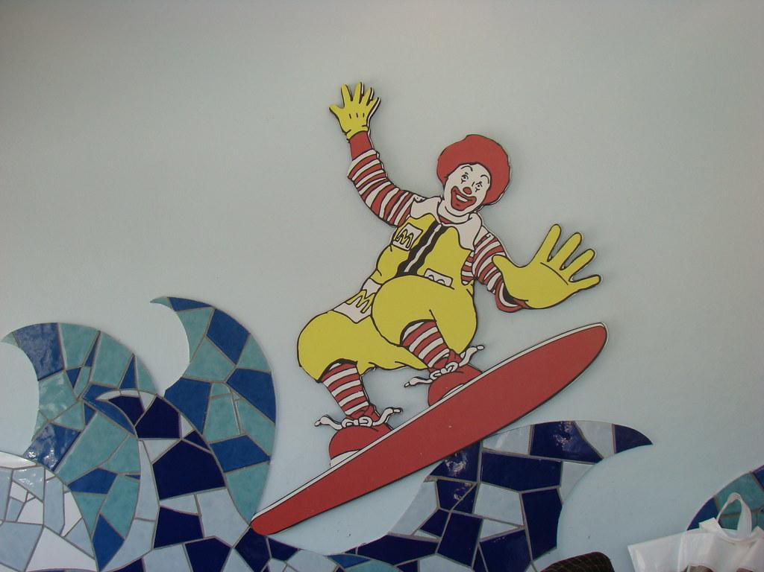
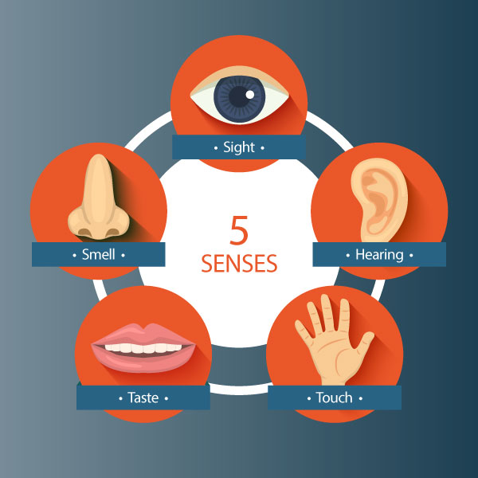

Slide 8
Current architecture

Slide 9
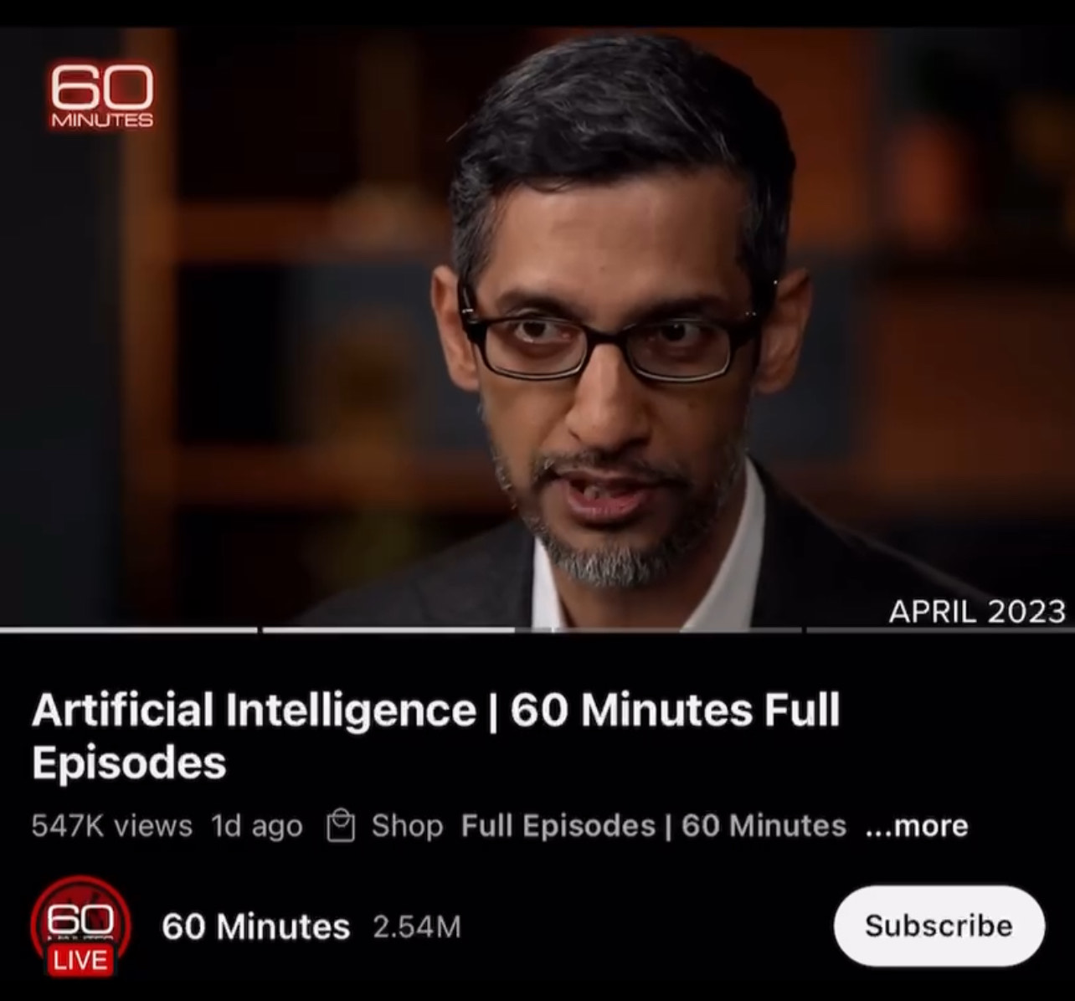
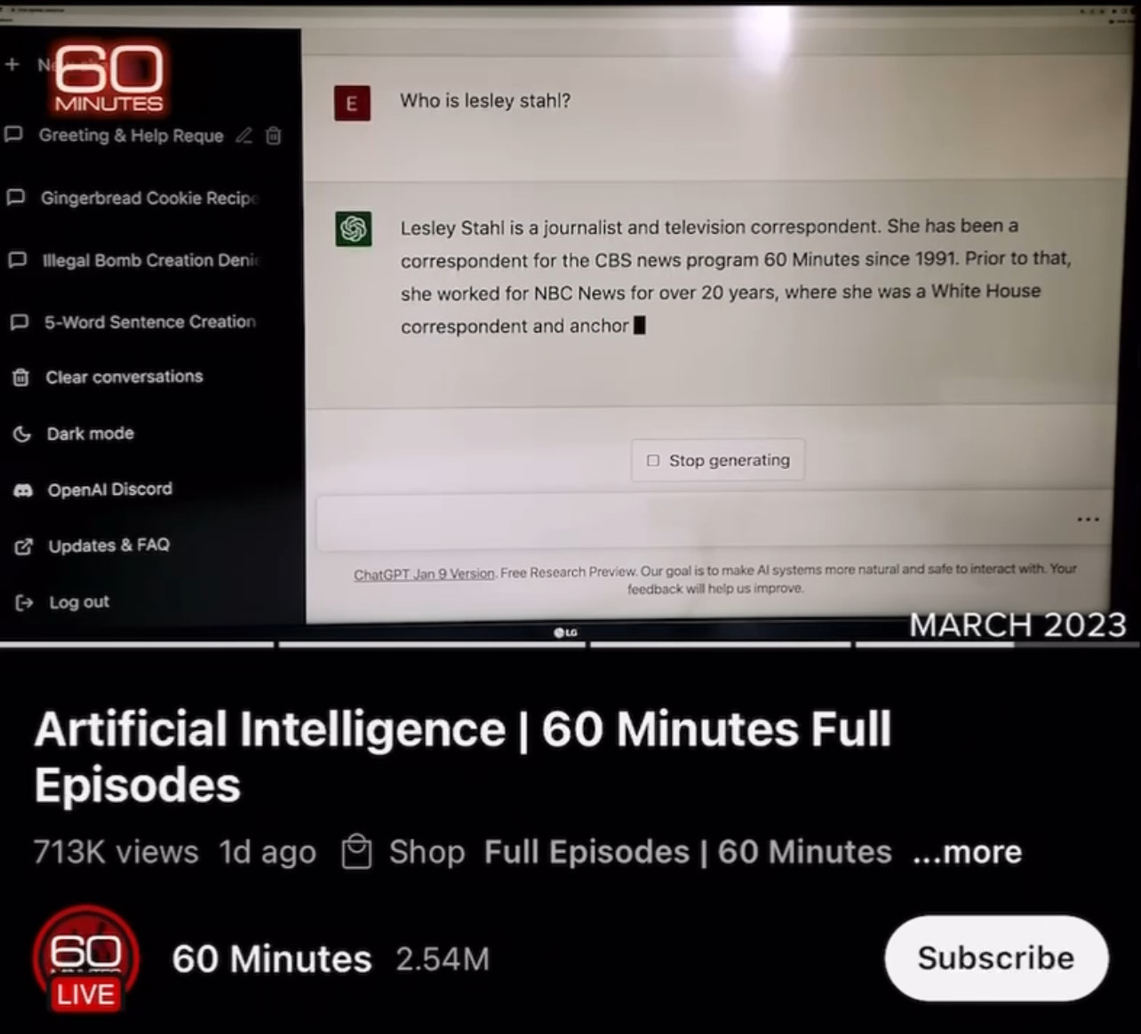
Black boxes & hallucinations

Slide 10
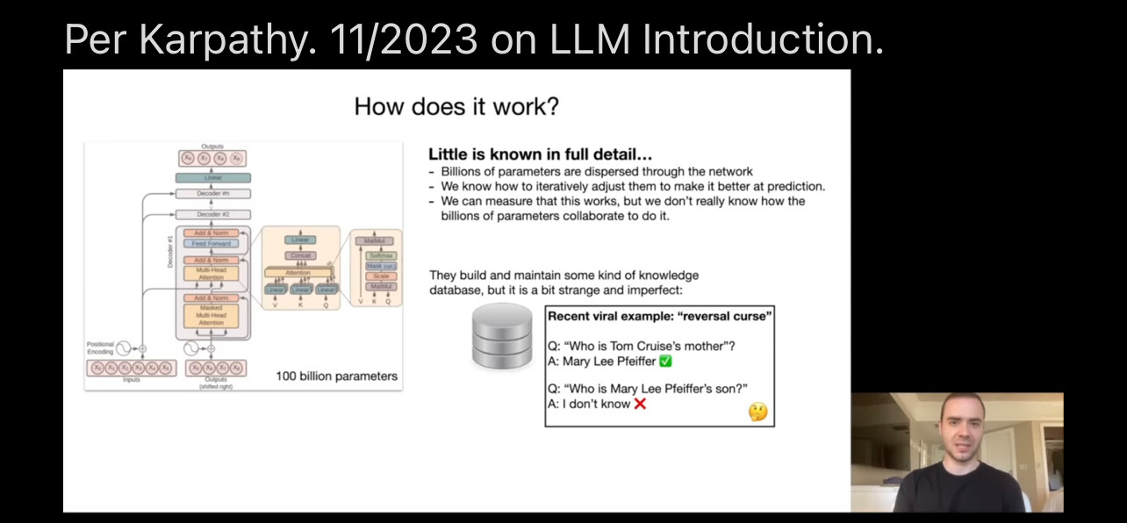
Black boxes & hallucinations

Slide 11
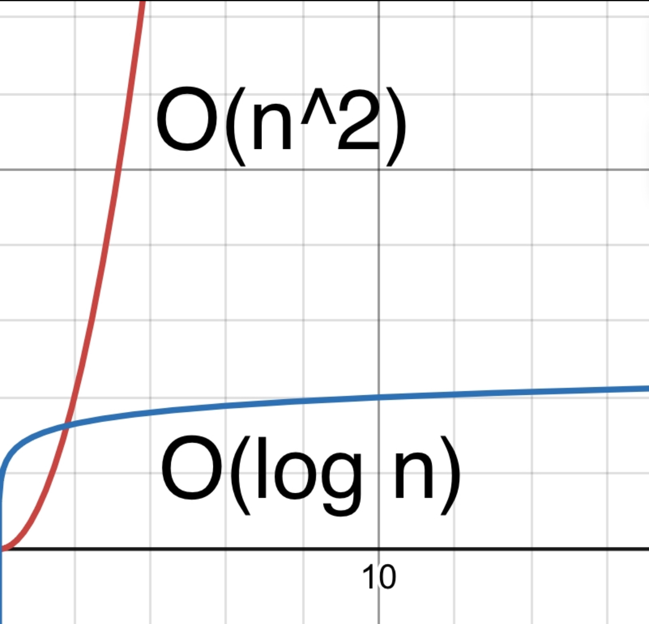

Slide 12
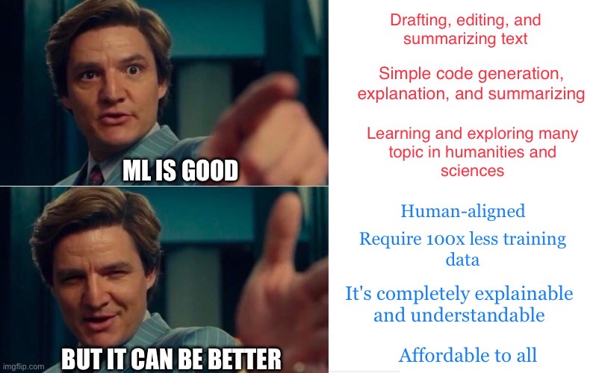

Slide 15
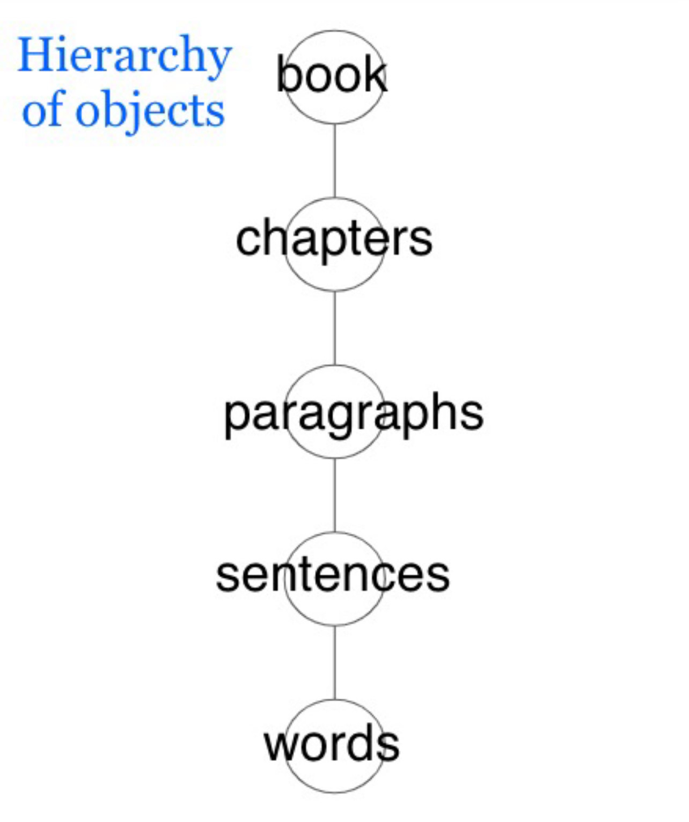
Hierarchical nature of world

Slide 16
Hierarchical nature of world

Slide 17
Hierarchical nature of world

Slide 18
Hierarchical nature of world

Slide 19
Hierarchical nature of world

Slide 20
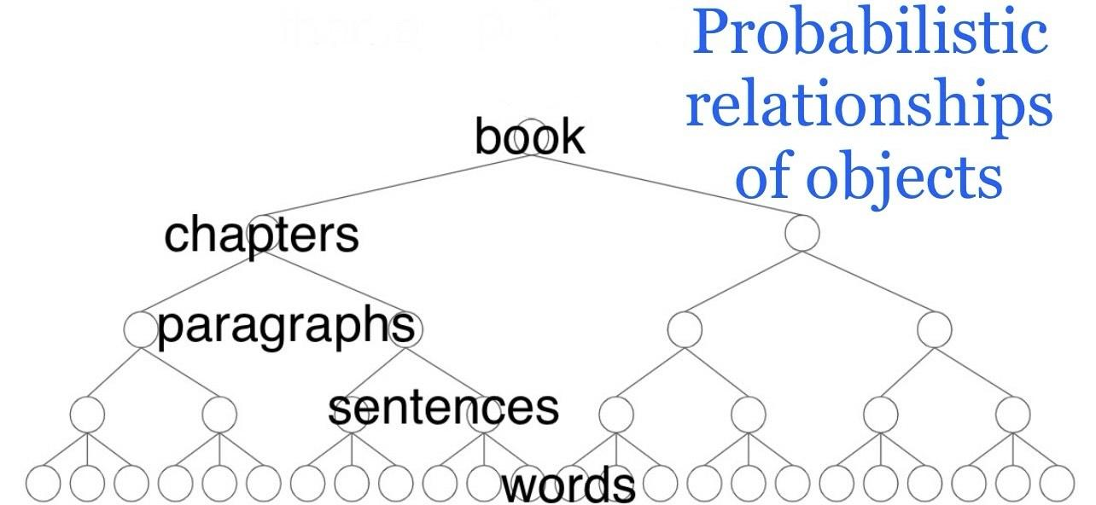
Learning described in probabilities

Slide 21
Learning described in probabilities

Slide 22
Learning described in probabilities

Slide 23
Learning described in probabilities

Slide 24
Learning described in probabilities

Slide 25
Learning described in probabilities

Slide 26
Learning described in Hiearchical PGMs

Slide 27
Example
Nodes represent some concept
Edges (lines) describe relationship
Eating sentence
the
girl
ate

Slide 28
Recap
LLMs very useful
It has major challenges
Time to upgrade to Hiearchical PGMs

Slide 29
Resources
pebreo.github.io/chipy2024
- “LLM” series by 3blue1brown
- Dileep George on Lex Fridman podcast
- Scott Phoenix on TWIST podcast
- A Thousand Brains by Hawkins

